Slide 1

SIDDHARTH INSTITUTE OF ENGINEERING & TECHNOLOGY (AUTONOMOUS)
DEPARTMENT OF ELECTRONICS AND COMMUNICATION ENGINEERING
SECTION NO. -02
BATCH NO -05
REAL TIME OBJECT DETECTION FOR EFFECTIVE INTELLIGENT TRANSPORT SYSTEM USING RASPBERRY PI
TEAM MEMBERS:
THUPAKULA JAANVI 19F61A0468
MOOLINTI JITHENDRA 19F61A0476
PINJARI KHAJA 19F61A0483
V K KARTHIK 19F61A0482
CHENNIKAYALA GURUPRASAD 19F61A0455
Under the esteemed guidance of :
Mrs. D.SAKUNTHALA,M.TECH(Ph.D),
ASSISTANT PROFESSOR

Slide 2
ABSTRACT
Intelligent transport system (ITS) is not just limited to traffic congestion control and information, but also for road safety and efficient infrastructure usage.
The problem related to traffic is a complex one requiring proper design and planning for developing a solution.
For safety and harmony in the flow of traffic, drivers are expected to pay attention to identify, interpret and follow certain rules while driving. Misinterpretation of traffic signs and signals may lead to catastrophes.
An automatic system in a car which detects, recognizes, interprets traffic signs, traffic signals and pedestrians effectively and gives warning to the driver would be of great help in reducing the misinterpretations and accidents.

Slide 3
In the present study, traffic sign and signal recognition system has been developed to increase the safety of the road users by installing the developed hardware system inside the car which gives an audio output for alerting the driver.
The algorithm is embedded into Raspberry Pi 4 prototype for processing and analysis to detect the traffic signs, signals and pedestrians from the real-time video which will be recorded by a camera placed in the system and produces an audio output to alert the driver.
Keywords:Open CV,Tensor flow,Rapberri pi 4

Slide 4
MOTIVATION BEHIND THE PROJECT
In USA over 37,000 road accident deaths, 2.35 million injured/disabled each year. Road crashescost U.S. $230.6 billion per year. In GerAccording to US DOT, V2V can reduce or prevent 80% of crashes. Road traffic caused death estimated over 1.20M worldwide each year by WHO.
Many last year 2.6M road accidents with 3214 deaths according to DW Media.
Current traffic safety infrastructure and human driver-based interactions are not entirely safe. It was based on these difficulties with other related transportation problems which expedited the evolution of V2V communication since its inception in 1999.

Slide 5
LITERATURE SURVEY
S.no | Author | Title | Problem | Summary
1 | B. Williams | Intelligent Transport Systems Standards | Cost is high Low efficiency Packet error rate is high | A promising technology for vehicular communication for safety measures, evaluation of the performance impact of varying channel conditions done, impacts of energy efficient packet error rate, rate of collision and successful packet transmission with respect to throughput performance.
2 | J. Zhang et al., | Data-Driven Intelligent Transportation Systems | Design Cost is high Performance is low | In capable of tackling the severe interferences present in the open based road to developing wireless technology has properly chosen which is a complete DSRC system for Intelligent System using combined digital technology along with reception diversity like spread spectrum. This type of DSRC system is operational in its basic form with several mobile users over a distance of 500 meters and for more efficiency radio channel is categorized.

Slide 6
S.no | Author | Title | Problem | Summary
3 | Yiyan, W., et al. | Video Image Vehicle Detection System for Signaled Traffic Intersection. in Hybrid Intelligent Systems | conventional routing is not possible Performance is low Implementation cost is high | This has more reliability but drawback is conventional routing is not possible. But overcome the demerit thus by determine reliable routes for this mechanism to find vehicle information from the source vehicle to destination, but for this latency is a problem which is low.
4 | Haoui, A., R. Kavaler and P. Varaiya | Wireless magnetic sensors for traffic surveillance | Design Cost is high | An idea of internet usage by visible light communication, which can give the way for communication to establish a smart wireless network grid, underwater communication grid with mobile services. Standardization of GPS in cell phones and vehicles in traffic explains One of the major advantage is increased accuracy when compared to heavily relying on cell information, in triangulation method.

Slide 7
PROPOSED SYSTEM
Raspberry Pi is a mini-computer that is capable of running applications as a computer .
It is one of the most popular single-board controllers and is affordable with number of resources available.
In the present study, Raspberry Pi 4 module is used to run the Tensor Flow algorithm and is connected to a camera mounted at the mirror level of the car to record the real-time video.
A Raspberry Pi display module displays the related information of the detected traffic signs, signals, and the pedestrians if they suddenly come across the road and a speaker module to give an audio output as an alert to the driver.
Fig.1 shows the complete hardware of the developed system. The system will be deployed in a car on the dashboard and is powered using power car adapter.

Slide 8
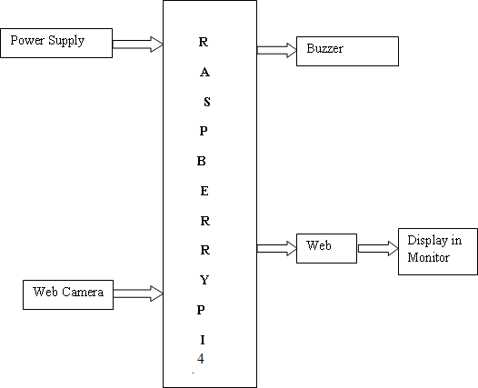
BLOCK DIAGRAM & METHODOLOGY

Slide 9
HARDWARE DETAILS
Raspberry Pi 4
Buzzer
Power supply
LCD Display
Monitor
Web camera

Slide 10
SOFTWARE DETAILS
Tensor Flow Algorithm
Open cv
Python Language

Slide 11
RESULTS AND DISCUSSION
In the present work, we have a assumed a car with the prototype developed which is placed at the dashboard of the vehicle moving ahead and the images are captured and are divided into frames through a real time video stream recorded from the camera mounted.
The Raspberry pi is used to read the frames with a minimum resolution of the pixels and frame rate set and the FPS rate can be increased using python and Open CV.
For the object detection, Tensorflow model is used for training and testing where it will grab the frame from the video and resize it to expected shape.
It will perform the actual detection by running the model with this image as input and retrieve the detection results.

Slide 12
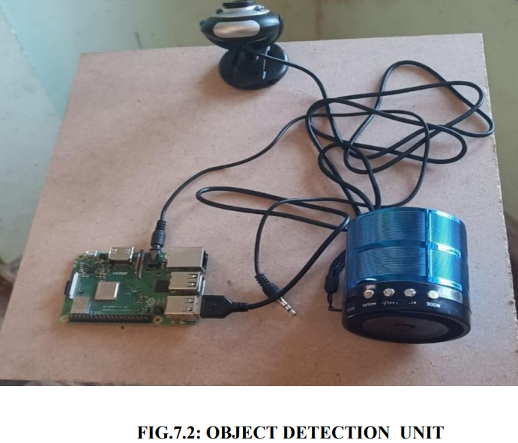
The MobileNetv2 pretrained model is used to train the system to detect certain traffic signs, traffic signals and pedestrians which are captured through the real-time recording video using Raspberry Pi camera to alert the drivers.
Five different classes of images that includes Stop Sign, Speed Limit 25, Speed Limit 40, Traffic signals (Red and Green) and pedestrians (Humans) have been considered for the real-time tested implementation.
The performance of the developed system has been evaluated in terms of accuracy, delay and reliability.

Slide 13
FUTURE SCOPE
VLC has extraordinary potential for future ITS environments, as deep learning technique can be acquainted with it to get to the next level framework execution.
A real time VLC prototype using Raspberry Pi for detection of traffic sign based on light communication for controlling the vehicle’s status and also transmitting the safety messages to the vehicle at the back with an alerting system.
We carried out experimental measurements in terms of the eye diagram, beam profile at different link spans and light intensity of LED array for a range of offset angles in between two vehicles for the successful communications.

Slide 14
APPLICATIONS
Vehicle and Pedestrian Detection:
Real-time object detection can help detect vehicles, pedestrians, and other objects on the road, providing drivers with real-time information about the traffic conditions ahead. This can help improve road safety and reduce the risk of accidents.
Traffic Management:
Real-time object detection can be used to monitor traffic flow and manage traffic congestion. The system can provide information about the number of vehicles on the road and their speed, allowing authorities to make informed decisions about traffic management.
Parking Management:
Real-time object detection can help detect available parking spaces and provide information to drivers. This can reduce the time drivers spend looking for parking spaces, leading to reduced traffic congestion and improved air quality.

Slide 15
Road Maintenance:
Real-time object detection can help detect potholes, cracks, and other road defects, allowing authorities to take corrective measures before they become major safety hazards.
Autonomous Vehicles:
Real-time object detection can be used in autonomous vehicles to detect objects on the road and make decisions based on that information. This can help improve the safety of autonomous vehicles and reduce the risk of accidents.

Slide 16
REFERENCES
[1]Qinghua Xiang, Yingxiu Li, Wenting Huang, Wenxuan Ye, and Jianhua Shen,” Deep Learning assisted Visible Light Communication based Intelligent Transport System”, 2019 18th International Conference on Optical Communications and Networks.
[2] W.-L. Jin, “SPIVC: A Smartphone-based inter-vehicle communication system,” Proceedings of Transportation Research Board Annual Meeting, 2012.
[3]A. Boukerche et al., “Vehicular Ad Hoc Networks: a new challenge for localizationbased systems,” Computer Communications , ScienceDirect, pp. 1-12, 2008.
[4]N. M. Husain Fidvi, “Car to Car Communication System,”source:car communication system,[AvailableOnline:http://www.engineersgarage.com/contribution/cartocarcommunicationsystem?
[5]FCC,[AvailableOnline:http:/www.fcc.gov/Bureaus/EngineeringTechnology/News_Releases/1999/nret9 00 6.html], October, 1999.

Slide 17
[6] T. H. M. A. Y. K. K. K. Isamu Takai, “Optical Vehicleto-Vehicle Communication System Using LED Transmitter and Camera Receiver,” IEEE Photonics Journal, Vol. 6, No. 5, pp. 7902513-7902513; October 2014.
[7] Haoui, A., R. Kavaler and P. Varaiya, 2008. Wireless magnetic sensors for traffic surveillance. Transportation Research Part C: Emerging Technologies, 16(3): 294-306.
[8] H. Elgala, R. Mesleh, and H. Haas, “Indoor Broadcasting via White LEDs and OFDM,” IEEETrans. On Consumer Electronics, Vol. 55, No. 3, pp. 1127-1134, Aug. 2009.
[9] W. Jia-yuan, Z. Nian-yu, W. Dong, I. Kentaro, I. Zensei and N. Yoshinori, “Experimental study on visible light Communication based on LED,” The Journal of China Universities of Posts and Telecommunications, Vol.19, No. 2, pp. 197 200, October 2012. 10.
[10] H. Elgala, R. Mesleh, H. Haas and B. Pricope, “OFDM Visible Light Wireless Communication Based on VLSI”,2013

Slide 18
[11] 11.Yiyan, W., et al. 2009. Video Image Vehicle Detection.
[12]White LEDs,” In the Vehiclar Technology Conference Proceeding, pp. 2185-2189, 22-25, April, 2007.
[13] 13.N. Lourenco et. al, “Visible Light Communication System for Outdoor Applications,” In the 8th International Symposium on Communication Systems, Networks and Digital Signal Processing, pp. 1-6.18-20 July 2012.
[14] 14.W.-L. Jin, “SPIVC: A Smartphone-based inter-vehicle communication system,” Proceedings of Transportation Research Board Annual Meeting, 2012.
[15] A. Boukerche et al., “Vehicular Ad Hoc Networks: a new challenge for localizationbased systems,” Computer Communications, Science Direct, pp. 1-12, 2008.
[16]3rd Generation Partnership Project: Technical Specification Group Radio Access Network; Study on LTE-based V2X Services (Release 14), 3GPP TR 36.885 V2.0.0, Jun.2016.

Slide 19
[17] W.H. Organization.(June 2011).Fact Sheet 310 – The 10 causes of death.Availablehttp://www.who.int/mediacentre/f actsheets/fs310/en/W .H. Organization.(September 2011). Fact Sheet 358 Road Traffic Injuries Available: http://www.who.int/mediacentre/factsheets/fs358 /en/ .
[18] N. M. Husain Fidvi, “Car to Car Communication System,” source: carcommunicationsystem,AvailableOnlinehttp://w ww.engineersgarage.com/c Contribution/car-tocar-communication-system? Page=]
[19] M. Alsabaan, K. Naik,T. Khalifa,A. Nayak, ”Vehicular networks for reduction of fuel consumption and CO2 emission”, Industrial Informatics (INDIN), 2010 8th IEEE International Conference on , pp.671-676, 13-16 July 2010.
[20] B.Zhou, J.Cao,H.Wu,Adaptive traffic light control of multiple intersections in WSNbased ITS”,978-1- 4244-8331,IEEE,2011.

Slide 20
THANK YOU

